Slide 1
Red Hat Linux 9 Basics
CHAPTER 2

Slide 2
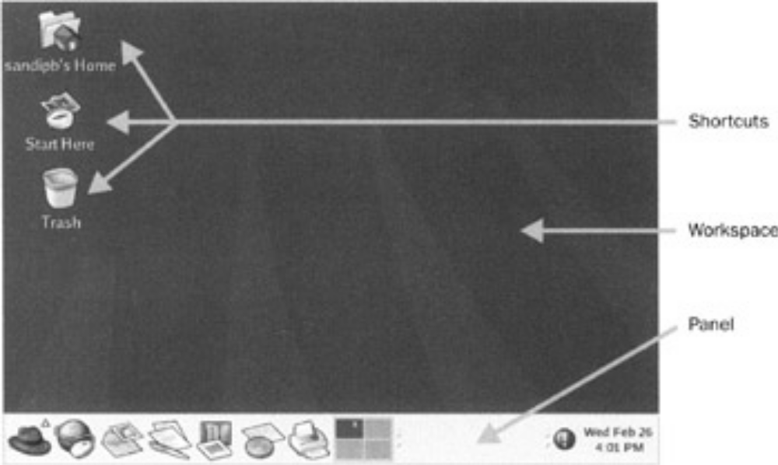
Moving Around the Desktop
GNOME desktop
  Stands for GNU object model environment
  Installed by default for Red Hat Linux 9

Slide 3
There are other desktop interfaces. One such is the KDE desktop, which is included in the Red Hat Linux 9 distribution but not installed by default.
To install it, you'll need to install the necessary KDE packages.

Slide 4
2 components
The 2 main components of this desktop interface:
The panel: complete gray rectangular box at the bottom of the screen
The workspace:
  the large area that makes up most of the screen
  Typically have 4
  Open application windows

Slide 5
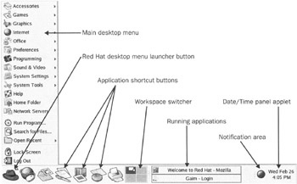
Panel
Hjh

Slide 6
The panel
It contains
  Various shortcut buttons (which launch applications when clicked)
  a menu that provides access to more applications
  a workspace switcher
  an application tab bar
  a status notification bar &
  the date−time applet.

Slide 7
The workspace
The workspace:
  When you run (or launch) a GUI application, it becomes visible in the workspace.
  By default, Red Hat Linux places a few application shortcuts (or launchers) on the workspace.

Slide 8
The panel
At the left−most end of the panel (the Main menu button), you bring up the main desktop menu.
The next six items of the panel are shortcut buttons for various frequently used applications −browsers, mail applications, word processors, spreadsheets, and a printer manager.
The square (with four equal divisions in it) is the workspace switcher.

Slide 9
The panel
Next we have the application task bars for switching between the GUI applications that are currently running in the workspace.
At the right−most end of the panel we have the notification area, where various applications can indicate their status using icons:
  Eg The red round icon with an exclamation sign is the Red Hat Network Agent icon, which is indicating critical updates pending for your desktop.
Finally, there is date and time applet, which displays the current date and time in the desktop.

Slide 10
Shutting Down the Computer
The options for logging out and shutting down are all controlled by the Main Menu | Log out option

Slide 11
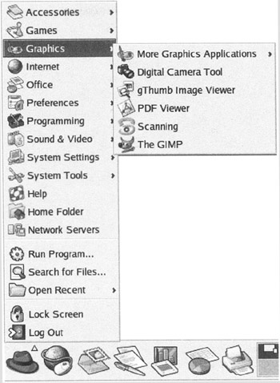
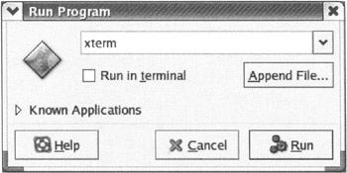
Using Applications
Using the Main Menu
Using the Run Program...

Slide 12
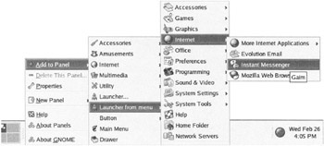
Panel Shortcuts
Adding New Shortcuts to the Panel
Changing the Size of the Shortcut Icons
    By right clicking on the panel and selecting Properties. Then, in the Edge tab of the resulting dialog, select the appropriate value in the Size field (the default value is Medium)

Slide 13
Using a Terminal Emulator
The interface in a terminal emulator is completely character−based and non−graphical.
  Run program... window (by pressing Alt−F2) and type in the name gnome−terminal;
  or select Main Menu | System Tools | Terminal

Slide 14
Pros and Cons of the CLI
Using a CLI has advantages over the GUI, but it has disadvantages too:
To execute programs in this interface, you need to know their names. Unlike a GUI menu interface where the available options are visible, the CLI doesn't offer such ready convenience.
However, a GUI is generally limited by the amount of space available in the display screen. Even after proper organization using menus, it is difficult to put each and every program of the operating system at your reach, and too many levels of menu makes accessing a given program more long winded. In contrast, using a CLI you can reach at all the programs that are available.

